Slide 1
To adapt to electronic meeting formats WSO is introducing these services for newcomers:
A personal Welcome Email
An electronic version of “Welcome, Newcomer” (eK-10)

Slide 2
To receive welcome email type al-anon.org/welcome and enter the email address

Slide 3
They will be redirected to the Al-Anon website’s Newcomers page:

Slide 4
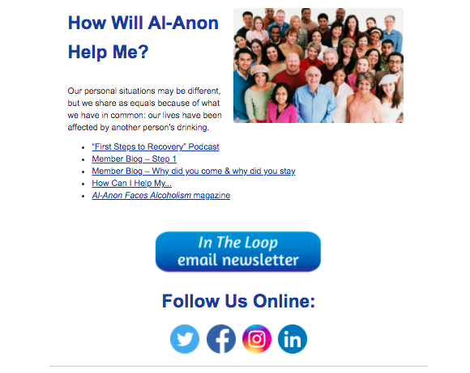
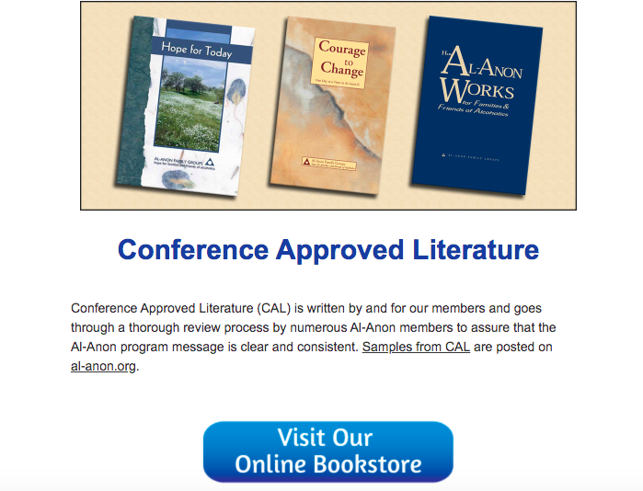
Meanwhile, the newcomer will be sent an email that includes a number of helpful resources and links:

Slide 5
An electronic version of Welcome, Newcomer (eK-10), is coming soon
The electronic version of the Al-Anon Newcomer Packet (K-10) is in the final stages of production.
It will be available through a variety of vendors, just as our current eBooks are.
More details will be announced soon.
Until then, newcomers in electronic meetings can use al-anon.org/welcome and enter their email address.

