Slide 1
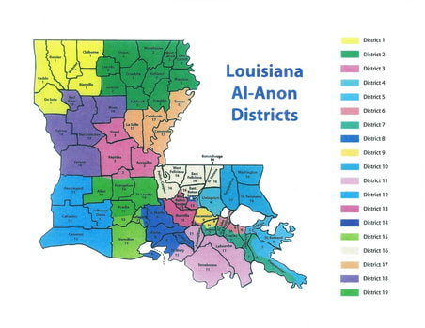
Assembly Report May 22,2021 tammy Mergist Panel 60 Delegate

Slide 3
Two Historical decisions.
WSC recognize permanent electronic meetings as Al-ANON Family Groups.
Allow Creation of non-geographically based Areas, the first of which be a non-panel Area for groups which to meet on electronic platform
Notes:
Two Historical decisions were made at this year’s WSC
The first decision was to recognize permanent electronic meetings as AL-ANON Family Groups. The Second was to allow creation of non- geographically based Areas, firt of which will be a non-panel Area for groups which meet on electronic platform. These decisions allow groups which meet electronically to elect all service positions identified in the Service Manuel , including a Groups Representative (GR). Everything in the Service Manual will equally to all groups whether they meet physically or face to face.

Slide 4
The WSC Conference gave traditional approval and during the Annual meeting The Board of Trustees, in their legal capacity, elected the following
Regional Trustees:
Debbie P., Canada Central 1st 3year term
Tony S., Canada East 1st 3year term
Linda R., US Southeast Remaining 1yr of a 1st 3yr term

Slide 5
Trustees at Large
Lynette K., 2nd 3 yr. term
Don B., 1st 3 yr. term
Kathi M., 1st 3 yr. Term
Nancy S., Remaining 2 yrs. Of a 1st 3 yr. term

Slide 6
Board Officers 2021-2022
Lynette K., Chairperson of the Board
Marianna B., Vice Chairperson for the Board
Cindy M., Treasurer

Slide 7
Executive Committee
Chairperson of the Executive Committee
Deborah (Debbie) G.
Executive Committee for the Real Property Management Chairperson
Elizabeth (Liz) D. 1yr term
Deborah (Debbie) G., 3rd. 1 yr. term
Terry F. 2nd. 1 yr. term
David B. 1st 1 yr. term

Slide 8
Cleveland, OH on October 23,2021
Save the date---
Road Trip
Notes:
May 2022 WSO provided a registration form to the Area for local distribution. The WSO will also publish event details in AFG Connects communities and In The Loop. Be on the look out for this information.

Slide 9
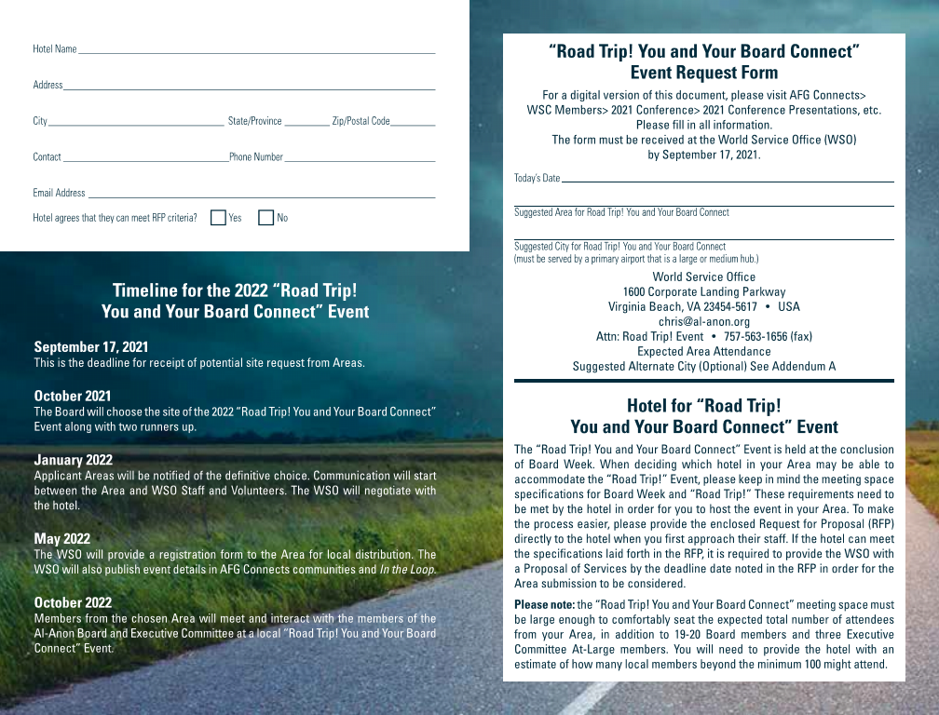

Slide 10
Longitudinal Study membership survey Survey will be available in English, Spanish and French link to the survey is al-anon.org/membershipsurvey June 16,2021- July 27, 2021
Notes:
WSO staff began the process of developing the 2021 Membership Survey in 2020. During the process, Staff reached out to research professionals in the field of alcoholism/addiction asking for their opinions regarding our survey process. The professional suggested a longitudinal study , which consist of asking the exact same group of member the exact same questions over a period of 5 to 10 yrs. This would all the WSO to track an Al-Anon member to understand the impact that consistent Al-Anon membership has on mental health, etc. As with the Membership Survey, the data would be anonymous. The Longitudinal Study participants will be selected at random from members who opt-in at the time they take the upcoming Membership Survey. Members who opt-in to the longitudinal study will be contacted via email and asked a set of 10 question, the same questions each year, for a period of five years form 2022-2026

Slide 11
2023 Al-Anon International Convention with A.A. Participation
June 29-July 2, 2023
Albuquerque!

Slide 12
This fun-filled virtual event will take place on Saturday, July 10, 2021, from 2:00 pm -4:00 EDT.
Al-Anon's 70th Anniversary Virtual Celebration.
LaCélébration des 70 ans des Groupes Familiaux Al-Anon.
-Celebración del 70.º Aniversario de Grupos de Familia Al-Anon.
Notes:
Maximum 500 people

Slide 13
Finance update
Year to Date (YTD) March 2021
The following information is based on the un-audited financial statements
For the period that ended 03/31/2021
Revenue YTD Actuals YTD Budget Total Budget
Literature Sales–net $469,080 $449,099 $1,924,400
Contributions $688,924 $671,311 $2,882,110
Other income $158,920 $146,250 $585,000
Total Revenue $1,316,924 $1,266,660 $5,391,510
Total Expenses $1,211,867 $1,366,322 $5,465,290
Net
Increase/(Decrease) $105,057 $(99,662) $(73,780)
Literature sales for March were $191,559
Contributions for March were $292,245
Expenses for March were $426,296
Change in net assets resulted in a net increase of $105,057 which reflects the decrease in expenses.
Investments had a unrealized gain of $554,258

