Slide 1
Unlocking the Secrets of Concepts
This presentation is based on my own experience and knowledge.
It is simplified for the benefit of new volunteers.
Your interpretation may vary as there is room for nuance.
As you gain experience you will discover a wealth of additional information.

Slide 2
Unlocking the Secrets of Concepts
Part II
Things We Covered During Part I
Vision
A vision that has the potential to transform millions of lives will overcome obstacles and thrive.
Begins with a handful of people then grows exponentially into a large organization serving millions.
Google was started in a dorm room by two students.
Microsoft was started in a garage by one person.
Al-Anon was started by two ladies in a small office at Stepping Stones.
All such organizations have overcome many obstacles and grown exponentially transforming many lives.
Without a well-organized work force this is not possible.
Our Concepts of Service guide our service volunteers to create a dynamic organization.
Such organization works tirelessly to transform the vision into reality.
Such success attracts new volunteers to be a part of a success story.

Slide 3
Underlying Principles of the Concepts
Razor Sharp Focus on the Vision – Our guiding force, our commitment
Singleness of our Purpose
Fully Self-supporting
Obedience to the Unenforceable
Delegation – Build strong organization, comfort zone
Affective Delineation of Ultimate Authority
Organizational Structure
Clearly Defined Responsibility and Authority
Trust
Defined Duties and Qualifications
Policies and Procedures
Leadership – Commitment, foresight, team building, role modeling
Maintain Razor Sharp focus on our Vision
Sufficient Knowledge of our Traditions and Concepts
Create Environment to Welcome Participation, Discussions
Setting Priorities and Time Management
Operate Within the Assigned Authority and Responsibility
Conflict Resolution Skills
Seek Greater Good
Communications – blood supply of our fellowship
Group Conscience
We are All Equals
Every Opinion Counts
Keep an Open Mind
Respect Boundaries
Fostering Goodwill – trusted servants, unconditional love, God’s will
Code of Conduct – Remain True to our Legacies
Principle Above Personality
Democratic Process – Dominance. Gossip, Discussion of Religion - xxx
Obedience to the Unenforceable

Slide 4
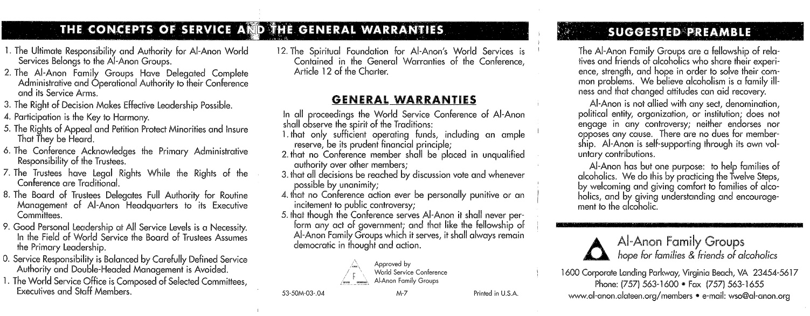
Use above page as a cheat sheet.
Observe the leaders in action.
Try to identify which of these underlying principles they are tapping into.
Then try to see if you can identify which Concepts are in action.
Keep M-7 in your wallet.

Slide 5
Key Concepts that Delineate Ultimate Authority into Manageable Workforces Through Delegation
Tradition Two – for our group purpose there is but one authority a loving God…. – Ultimate Authority
Concept One – The groups are in charge of the Fellowship. – Buck Stops Here
Concept Two – Groups have delegated significant portion of the ultimate authority to the Delegates.
Largest authority delegated to a single individual
Concept Six – The delegates have delegated administrative authority to the Board of Trustees for managing WSO.
Here the rubber meets the road.
Concept Eight – The Board of Trustees have delegated routine management of WSO to Executive Committee. – Department heads
Concept Eleven – Routine management of the WSO is further delegated to Select Committees, Executives and Staff Members.
Busy bees
Delineation of Ultimate Authority
God → Groups → Delegates → Board of Trustees → Executive Committee →Select Committees, Executives and Staff members

Slide 6
Unlocking the Secrets of Concepts
Part II
Today We Will Cover the Remaining Concepts
Concepts 3, 4, 5, 7, 9, 10, and 12 –
Tall order, we will try at warp speed

Slide 7
Concepts 3, 4 and 5 – Defining our Rights:
Right of Decision:
Diligent execution of bestowed authority
Setting goals and developing plans to achieve set goals
Bold, courageous, assertive
Lack of assertiveness will promote double-headed management and unqualified authority
Right of Participation:
Membership has privileges – All members are eligible to serve, just be willing
Unconditional love – Will receive more then you put in
God’s Will – Help families and friends of alcoholics
Reciprocate – Give back a little bit of the whole lot of love we have received
Right of Appeal:
Group Conscience gone awry -hasty, emotional, ill-prepared decision making
Submit minority opinion to the leader – list specific violation of guiding principles and potential harm (Minority opinion comes after the group conscience process, before group conscience all opinions have equal weight, no opinion is above the other, only pros and cons.)
Leader is responsible to resolve the conflict
Right or Petition:
Do not accept unacceptable behavior – Dominance, control, gossip xxx
Report such behavior to the leader
Leader must resolve this conflict immediately with utmost diplomacy
We must maintain a healthy environment where everyone feels safe and their freedom is protected

Slide 8
Concept 7 – Defining Rights of Delegates and Trustees
Traditional Rights of Delegates:
Manage overall functioning of the Fellowship
Define Fellowship’s short term / long term needs and set priorities
Can bring about complete reorganization of the WSO if necessary – SM p-170
Does not interfere with Trustees’ authority
Legal Rights of Trustees:
Develop plans to accomplish goals and priorities set forth by the Delegates.
Could override Delegates’ goal that cannot be accomplished within the budget and manpower
Manage overall functioning of the WSO
Protect copyright property, real property and intellectual property of the Fellowship
Manage all legal issues swiftly, decisively and independently

Slide 9
Concept 9- Leadership
Keep the Ship Sailing in the Right Direction Through Thick and Thin
Leadership – Commitment, foresight, team building, role modeling
Maintain Razor Sharp Focus on our Vision / goals / objectives
Sufficient knowledge of our Legacies
Create Environment to Welcome Participation, Discussions
Setting Priorities and Time Management
Operate Within the Assigned Authority and Responsibility
Conflict Resolution Skills
Seek Greater Good
Read Bill W’s essay on Leadership in the Service Manual – p195

Slide 10
Concept 10 – Setting Clearly Defined Boundaries
All Volunteers at every service level must know where their authority begins and where does it end
Loosely defined boundaries will result in:
Double-headed Management.
Overlapping boundaries
Gaps in boundaries
Under such conditions two leader may find themselves doing the same thing. This is referred to as double-headed management
Unqualified Authority
If the leader fails to act decisively then someone may step in and take charge. This is referred to as unqualified authority
Despite all good intentions this is very counter productive
These will result in turf battles, loss of efficiency and quality
Seek clarification from the leader to redefine:
Boundary of authority
Update policy and/or procedure
Update duty and qualification

Slide 11
Concept 12 – Obedience to the Unenforceable, Focused on Greater good, Unconditional Love, Trust the Process
Delegates, Trustees and Executives SHALL Observe the Spirit of the Traditions
All Conference participants must exercise prudence and balance in all that they do for the Fellowship. Take ample time and use all available resources to make wise decisions. Never be afraid to venture into unchartered territory however pursue with confidence and precautions. Minimize any negative fallout. We are all equals and treat each other with respect and dignity. Remain true to the Fellowship avoiding all outside distractions.
Warranty 1: Manage our money wisely only for the benefit of the Fellowship
Maintain sufficient operating funds for general functioning of the WSO
Maintain ample reserve to deal with unforeseen crises resulting in major expenditures
Conduct annual audit of finances and present annual budget to the Conference
Warranty 2: Unqualified authority – Dominance, control, ego, arrogance xxx
This kind of behavior is totally unacceptable and SHALL never be tolerated
Respect authority and work as a unified team
Understand leading roll and supportive roll

Slide 12
Warranty 3: Group Conscience, informed decisions
Through Thought Force, Task Force and KBDM develop all necessary information to empower the decision makers
Conduct a thorough discussion reviewing all pros and cons, risks and rewards
Listen to all opinions with equal weight
Seek greater good
Approve all motions with significant majority
Warranty 4: Treat each Conference participant with dignity and respect. No opinion on outside issues
Remain focused on principles over personalities
Avoid criticism, judgement and gossip
Avoid discussions of politics, religion or any such outside issues that can divert us from our primary spiritual aim
Use due diligence so as not to create any public controversy or draw negative attention to our Fellowship
Warrant 5: We are all equals, focused on greater good, avoid outside temptations, fully self-supporting
There is no room for any kind of human authority, only Loving God we bow to
We are all equals, treat each other with kindness and compassion avoiding any action that may be personally punitive or minimize one’s freedom
Remain focused on the future of our Fellowship avoiding all outside distractions
Trust and follow our process which is based on democratic principles shunning any kind of dominating force
Jay P.
August 21, 2021
For Louisiana Area Assembly

